Slide 1
PACUMEN
“packet acumen”
Notes:
DELETE ME!

Slide 2
Are you hiding all you intended? Probably not.

Slide 3
WHO AM I? BRANDON NIEMCZYK – HP DVLABS
Notes:
1 minute – brandon and prasad

Slide 4
We all know encrypting our data is good right?
Of course, that only hides what we are saying, not who we talk to.
Notes:
1 minute – brandon and prasad

Slide 5
So just tunnel everything through an encyrypted connection, like an SSH session.
Victim
Trusted endpoint
Internet
SSH
???
Attacker
Notes:
1 minute – brandon and prasad

Slide 6
Can the attacker infer anything using data mining techniques?
Notes:
1 minute – brandon

Slide 7
WHAT IS PACUMEN ?
A tool to identify what applications are being used over an encrypted tunnel.
Notes:
1 minute – brandon

Slide 8
ACADEMIA HAS PRODUCED PAPERS…
Where’s the code?
Notes:
3 minutes –prasad
Talk about the work acadamia has published

Slide 9
PREVIOUS WORK
Focus on one application at a time.
Results only.
Results are difficult to interpret.
Notes:
3 minutes – prasad (maybe brandon)
Talk about issues with existing research.

Slide 10
HOW DOES PACUMEN WORK?
PACUMEN learns by example.
Notes:
5 minutes (with next slide) – brandon
Talk about how pacumen works.

Slide 11
HOW DOES PACUMEN WORK?
10 Collect Training Data
20 Build Classifier
Collect Example Data
Train PACUMEN
30 Get unknown data
40 Classify unknown data
50 GOTO 30
Provide new data from network/pcap
Classifier
Classify new data
Notes:
5 minutes (with next slide) – brandon
Talk about how pacumen works.

Slide 12
HOW DOES PACUMEN WORK?
10 seconds
A
A
B
SIZE A
1
2
CLASSIFY
UPDATE
CONFIDENCE
SIZE B
1
IRRELEVANT SIZE
1
2
3
Notes:
5 minutes (with next slide) – brandon
Talk about how pacumen works.

Slide 13
HOW DOES PACUMEN WORK?
Multiple types of classifiers can be created.
- Decision Trees
- Mixed Gaussian Likelihood functions
Notes:
5 minutes (w/ prev slide) – brandon
Talk about how pacumen works.

Slide 14
DECISION TREES
Is it a dog or a house cat?
Is it heavier than fifteen pounds?
Does it bark?
Probably a dog
Probably a cat
Probably a dog
Notes:
5 minutes (w/ prev slide) – brandon
Talk about how pacumen works.

Slide 15
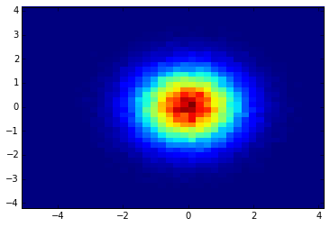
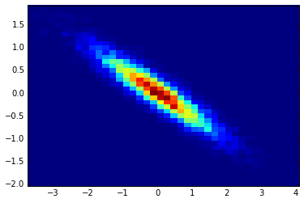
MIXED GAUSSIANS
M
=
Notes:
5 minutes (w/ prev slide) – brandon
Talk about how pacumen works.

Slide 16
What is the impact on privacy?
Not only social media data can be mined
Data that seems far more obfuscated can be just as revealing.

Slide 17
THANK YOU
Any Questions?
PACUMEN - https://github.com/bniemczyk/pacumen.git
Brandon Niemczyk – insecurity@hp.com
Prasad Rao – prasad.rao@hp.com
Vib Chhabra – vaibhav.chhabra@hp.com

